Slide 1
Domestic violence in the Health Sector
90 min workshop
Speaker(s):
Occasion:
Date: DD month 20YY

Slide 2
Outline of the Presentation
Topic
Topic
Topic

Slide 3
Introduction

Slide 4
What do this quote ring in you? What do they say about domestic violence?
Quote 1: ‘So many people don’t understand what domestic violence is about. It’s not all about being beaten up, it’s also not allowing you to see your friends; not allowing you your own money; it’s controlling your life in every possible way; no one can see it.‘
Task for reflection
After reading the quote, think about the ways in which you may have encountered the terms domestic violence and abuse so far. How do you define domestic violence and abuse? What does it mean to you and are you aware of any other terms used to describe the same phenomenon?

Slide 5
What do this quote ring in you? What do they say about domestic violence?
Quote 2: ‘Intimate partner violence is not the specificity of the poor and uneducated, like many people misbelieve. The wife of a well-known politician was sheltered here. Upper middle-class family. The husband was a well-respected community leader and a churchman. Some people knew what was happening behind closed doors. Kids had to witness how the father raped the mother. He even peed on the kids as a punishment for misbehaving. The man was so influential in his city that the Guardianship office refused to help when they realized that his name is involved. It was almost hopeless for the wife to escape from her prison, because most people would not believe her and those who believed her didn’t dare to help her.‘
Task for reflection
After reading the quote, think about the ways in which you may have encountered the terms domestic violence and abuse so far. How do you define domestic violence and abuse? What does it mean to you and are you aware of any other terms used to describe the same phenomenon?

Slide 6
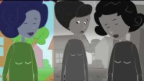
WHO - Video: Violence against women:

Slide 7

Physicians are important frontline responders!
Over 1 in 5 women make their first disclosure of domestic violence to their general practitioner.
You may be the only person the victim will tell.
Your skills and sensitivity are essential.

Slide 8
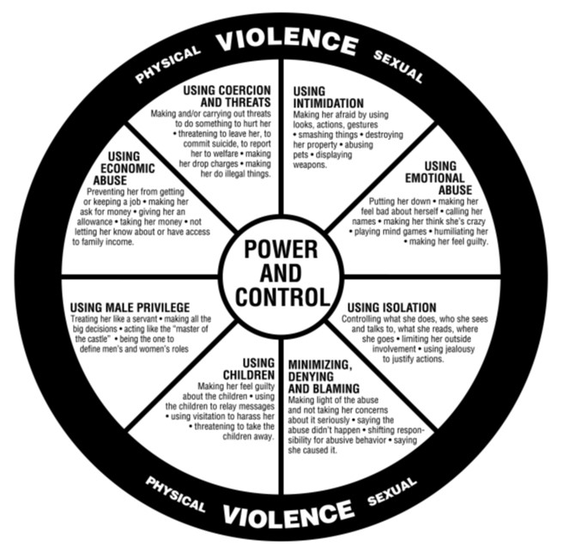
What includes domestic violence?
abuse of power within a domestic relationship
one person dominating or controlling another, causing intimidation or fear, or both
often experienced as a pattern of abuse that escalates over time
Notes:
Domestic violence is an abuse of power within a domestic relationship.
It involves one person dominating or controlling another, causing intimidation or fear, or both.
Domestic violence is often experienced as a pattern of abuse that escalates over time.
The Power and Control Wheel illustrates the most common abusive behaviours and tactics.
Detailed information on the forms and dynamics of domestic violence is provided in module 1.

Slide 9
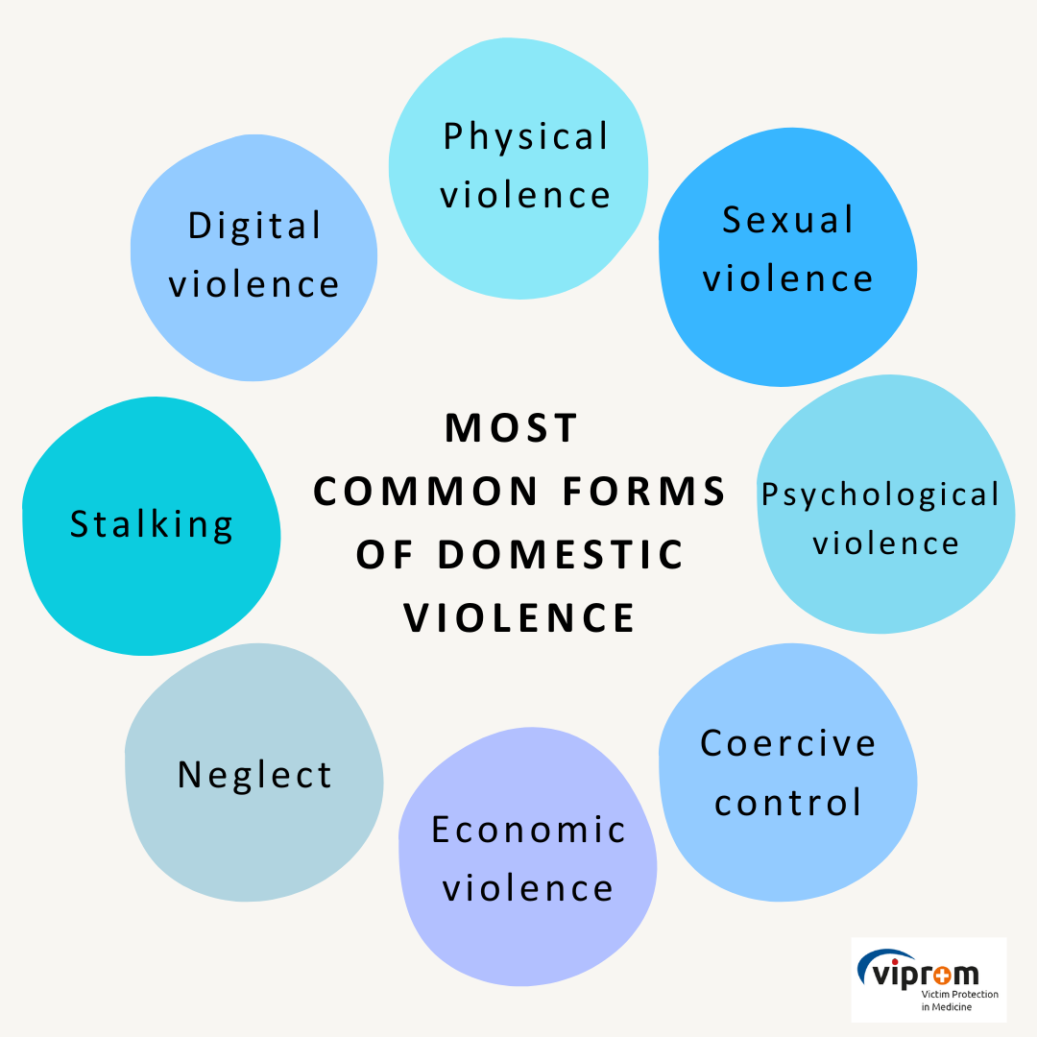

Common forms of Domestic violence
Image by storyset on Freepik
Which forms of domestic violence are unknown to you?
Notes:
Physical violence is any use of physical force or threat by use of physical force which compels the victim to do or to abandon or to suffer or restrict or move her/him or to cause her/him pain, fear or humiliation, whether personal injury has occurred.
Psychological violence is the conduct and dissemination of information by which the perpetrator of violence in the victim causes fear, humiliation, feelings of inferiority, danger and other psychological distress, even when committed using information and communication technology.
Sexual violence is the conduct of sexual content that the victim does not consent to, is coerced into, or because of their level of development, does not understand their meaning, the threat of sexual violence, and the public disclosure of sexual content about the victim.
Verbal Violence is part of psychological violence. Everything said by the perpetrator to or about the victim in order to harm him or her.
Economic violence is the unjustified control or restriction of a victim in disposing of income or property with which the victim independently disposes or manages or unjustifiably restricting the disposition or management of joint property of family members, unjustified failure to fulfil financial or property obligations to a family member or unjustified shifting financial or property liabilities to a family member.
Neglect is a form of violence where the perpetrator abandons the due care of the victim, which is needed due to illness, disability, age, developmental or other personal circumstances.
Stalking is a wilful repeated unwanted contact, pursuit, physical intrusion, observation, restraint in places where the victim moves or other form of unwanted intrusion into the victim's life.

Slide 10
Physical violence
Any use of physical force or
Threat by use of physical force
Aim of coercion, restraint, humiliation or the production of fear or pain
Minor, invisible traumas up to injuries of the internal organs up to murder
With or without aids (weapons, household objects)
Examples
Holding on, pushing, hitting, kicking, burning/scalding
Locking up the partner
Destruction of property
Harming family, friends, pets
administering medication or drugs against the victim's will

Slide 11
Sexual violence
Sexual acts on a person without their consent
Inequality of the interactors
Various forms:
  Rape
  Sexual abuse (sexualised violence)
  Sexual coercion
High potential for harm to the victim → Long-term therapies

Slide 12
Psychological violence
Emotional damage and injury to persons → Psychological stress
Many different dimensions
Gradual process
Often repeated use of violence and increase in intensity
Often perpetrated by relationship partners/ex-partners (often men)
Problem: no visible wounds

Slide 13
Indicators

Slide 14
Of note!
None or all of these might be present and be indicators of other issues
Using indicators as a guide can complement the practice of asking directly
Victims of domestic violence often see a physician without bringing up the violence.
Women in particular are often victims of domestic violence due to power relations, local customs, cultural background or given differences in strength.
Therefore, it is particularly important to recognise indicators and risk factors as such and to exclude other causes for injuries.
Notes:
The following are examples of indicators associated with victims of domestic violence.
Indicators of domestic violence are dealt with in more detail in module 2.

Slide 15
Physical Indicators - Adults
Adults
unexplained bruising and other injuries
miscarriages and other pregnancy complications
chronic conditions including headaches, pain and aches in muscles, joints and back
sexually transmitted infection and other gynaecological problems

Slide 16
Psychological Indicators - Adults
Adults
emotional distress
sleeping and eating disorders
self-harm or suicide attempts
alcohol or drug abuse

Slide 17
Other indicators
Several presentations in the emergency department
Patient arrives after the official consultation hour
Patient only comes in the presence of his/her partner, who has a controlling effect
Frequent absence, for example from work or study

Slide 18
Case study Ms. S.
What form of domestic violence is present?
Which indicators are recognisable in the following case study?

Slide 19

“Good morning Mrs Schmidt, what can I do for you today?”
“I feel totally overworked at the moment and wanted to ask if you could put me on sick leave for two weeks?”
“Is there any particular reason why you feel that way and has this happened before?”
“I have never been on sick leave because of work overload before. I have just recently separated and everything just gets too much for me at the moment.”
“Of course I can put you on sick leave, but if you feel so overwhelmed by your situation, I would be happy to offer you further support. Perhaps you would like to talk to me about it?”
Source: https://magazin.barmer.de/vorbereitung-arztgespraech/

Slide 20

Case study
“Mmm, I actually feel very uncomfortable to talk about it. There were some problems in my previous relationship. My boyfriend was a control freak and constantly checked my cell phone. We were always fighting whenever I wanted to meet with my friends or family. As a result, I became more and more isolated and the only company when leaving the house was my boyfriend. Messages from my friends were read by him before I had a chance to read them. I finally broke up, but I don’t know if that was the right decision.”
https://www.apotheken-umschau.de/Therapien/Gut-vorbereitet-fuers-Arztgespraech-553887.html
“If your boyfriend controlled and bullied you so much, why do you think the breakup was a mistake?”
“He keeps calling me and sending me messages. He puts me under pressure by saying that he cannot live without me and will hurt himself if I don’t come back. All the time I see his car in the parking lot: while shopping, being at work or meeting with friends. I always have the feeling that he is around. Can that still be a coincidence? I have already met him twice because I felt so sorry for him and I was afraid that he would really hurt himself.”

Slide 21
Reflection
What form of domestic violence is present?
Which indicators are recognisable in the following case study?
Image by storyset on Freepik

Slide 22
Physical Indicators - Children
Children
difficulty sleeping
physical complaints
eating disorders
slow weight gain (in infants)

Slide 23
Psychological Indicators - Children
Children
aggressive behaviour and language
bedwetting
restlessness and problems with concentration
noticeable decline in school performance

Slide 24
Case study: Gabby, Nick & Jane
Gabby married her husband Nick after a long relationship and shortly thereafter moved to her husband’s family farm. The couple were happy at the farm and soon had their first child. During the pregnancy Nick’s behaviour began to change and by the time their daughter was born the relationship did not ‘feel’ as it had before. Nick seemed withdrawn and spent long periods of time by himself. He began to remind Gabby of Nick’s father who had always been a stern presence in his life.
Nick’s behaviour became threatening and controlling, especially in relation to money and social contact. He was increasingly aggressive in arguments and would often shout and throw objects around the room. Gabby thought that because he wasn’t physically hurting her, his behaviour did not constitute abuse. Nick did not show much interest in their daughter, Jane, except when in public, where he would appear to be a doting and loving father.
What forms of domestic violence are present?

Slide 25
Case study: Gabby, Nick & Jane
Jane was generally a well-behaved child, however, Gabby found that she was unable to leave her with anyone else. Jane would cry and become visibly distressed when Gabby handed her to someone else to be nursed. This was stressful for Gabby and also meant that her social activities were further limited.
Jane took a long time to crawl, walk and begin talking. Her sleeping patterns were interrupted, and Gabby did not often sleep through the night, even when Jane was over 12 months of age. When Jane did begin to talk, she developed a stutter, and this further impeded her speech development. Gabby worried about Jane a lot. Their family doctor told her that this was normal for some children and if the speech problems persisted, that she could always send Jane to a specialist at a later date.
What possible indicators of domestic violence could be present here?

Slide 26
Case study: Gabby, Nick & Jane
After a number of years, Nick’s behaviour became unacceptable to Gabby. During arguments he had taken to holding the rifle that he had for farming purposes, and Gabby found this very threatening. On a number of occasions, items that Nick threw hit Gabby and she was increasingly afraid for their daughter.
What form of domestic violence is now present?
How do you assess the risk for Gabby and her daughter?

Slide 27
Case study: Gabby, Nick & Jane
Gabby decided to leave and consulted the local women’s service, who assisted her to get an restriction order against Nick.
Once Gabby had taken Jane away from Nick her behaviour changed. Jane’s development seemed to speed up and Gabby couldn’t understand why. As part of her counselling at a local women’s service, she discussed this issue and her counsellor recognised the developmental delay, stutter, irritation and separation anxiety as effects of Jane’s having lived in an abusive situation.

Slide 28
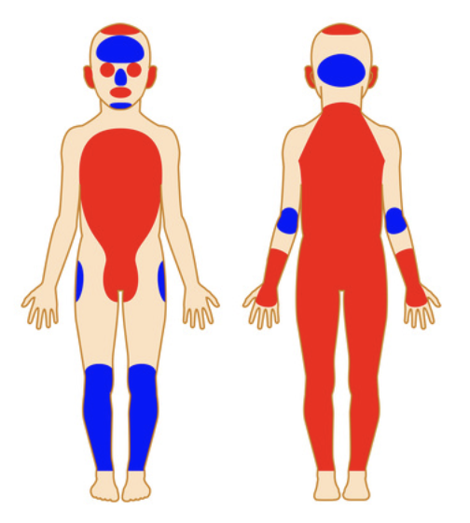
Injury patterns-children
Head:
Above the brim of the hat, cheek, ears, eyes
Extremities:
Backs of backs/buttocks
Handle marks:
Haematomas on upper arms and/or thorax
Fractures
Metaphyseal and epiphyseal corner fractures
Rib fractures
Skull fractures
Multiple or complex fractures
Large fracture clefts, flexion fractures
Involvement of multiple skull bones
Multiple injuries, different ages and locations
Rather suspicious body regions
Rather unsuspicious body regions

Slide 29
Communication

Slide 30
Never assume and always ask!
But how?
Image by storyset on Freepik

Slide 31
First step: take over victim´s perspective
They may feel…
Insecure
Lack of trust
Fear of potential consequences
Low self-confidence
Low self-worth
31
31

Slide 32
Communication (attitude) aspects
Respect
Trust
Confidence and empathy
Private
Exclusion of potential perpetrator or other familiy members
Use „I“ messages
Non-violent communication models

Slide 33
Possible questions
Start:
“I have some questions that I ask every patient. I’m going to ask you these questions now, too.”
General questions
Framing the question

Slide 34
Possible indirect questions
“How are things at home?”
“I know many people have problems facing violence by their partners, other family members, or someone else they live with. Could it be, that this is the same in your case?”
“Because unfortunately violence is so common in our society, I have started asking all of my patients about it.”
“I’m going to ask you a question that I ask all patients.”
Notes:
In any situation that you suspect underlying psycho-social problems you can ask indirectly and then directly about domestic violence.
If you have concerns that your patient is experiencing domestic violence, you should ask to speak with them alone, separate from their partner or any other family members.
You can always ask broad questions about whether your patient’s relationships are affecting their health and wellbeing.

Slide 35

Possible direct questions
“Are you ever afraid at home or in your relationship?”
“Have you ever been slapped, pushed or shoved by someone close to you?
Additive approaches by
non-verbal communication
International sign for help
Notes:
It is important to realize that victims who have been abused want to be asked about domestic violence and are more likely to disclose if asked.
If appropriate, you can ask direct questions about any violence.

Slide 36
How to talk to your patient about domestic violence – Specific questions
‘You seem very anxious and nervous. Is everything alright at home?’
‘When I see injuries like this, I wonder if someone could have hurt you?’
‘Is there anything else that we haven’t talked about that might be contributing to this condition?’
Use of interpreters:
Work with a qualified interpreter if your patient’s fluency in your mother tongue is a barrier.
→ Don’t use your patient’s partner, other family members or a child as an interpreter!
Notes:
If you see specific clinical symptoms, you can ask specific questions about these (e.g. bruising).
If your patient’s fluency in English is a barrier to discussing these issues, you should work with a qualified interpreter.
Don’t use your patient’s partner, other family members or a child as an interpreter. It could compromise their safety or make them uncomfortable to talk with you about their situation.
How to talk to victims of domestic violence is the subject of module 3. For more information, please visit this module.

Slide 37
Possible questions
Start:
“I have some questions that I ask every patient. I’m going to ask you these questions now, too.”
General questions
Framing the question

Slide 38
Response after disclosure

Slide 39
Principles: Responding to a disclosure
Listen
Communicate belief
Validate the decision to disclose
Emphasize the unacceptability of violence
Be clear that the victim is not to blame
Notes:
Your immediate response and attitude when your patient discloses domestic violence can make a difference.
Victims require an initial response to disclosure, where they are listened to, validated and their own and their children’s safety is assessed.
They also need to be assisted on a pathway to safety.
Aspects that should be considered after the disclosure of domestic violence such as medical assessment and securing of evidence are addressed in module 4.

Slide 40
Initial risk assessment
Evaluate the immediate and future safety of the victim
Seek relevant facts about their particular situation, and their own perception of risk
Use your professional judgment
Refer your patient to a specialized domestic violence service
Notes:
Assist your patient to evaluate their immediate and future safety, and that of their children.
Best-practice risk assessment involves seeking relevant facts about their particular situation, asking them about their own perception of risk, and using professional judgment.
You may need to refer your patient to a specialized domestic violence service.

Slide 41
Aspects of best-practice risk assessment
Speak to your patient alone
Check for immediate concerns
Check your patient’s future safety
Notes:
It is essential that you engage the person in a conversation about their perceptions of risk and how they have managed their safety in the past.
Find more information on risk assessment and safety planning in module 5.

Slide 42
Mandatory reporting – country-specific!
If a child is at risk of significant harm, you need to report this to Community Services/ the Youth Welfare Service
You are not obliged to report violence experienced by adults as long as there is no risk of suicide or endangerment of third parties
Reporting violence experienced by adults without their consent could put them at greater risk of harm

Slide 43
Stages of effective response
Non-judgemental listening & validation
Initial risk assessment
Note-taking for legal purposes
Referrals
Mandatory reporting
Continuing care
Notes:
Referrals: e.g. Police, Domestic Violence Line, legal advice, victim support
Note-taking for legal purposes: documenting injuries
Mandatory reporting: if required
Indicators of domestic violence are dealt with in more detail in module 2.

Slide 44
Documentation

Slide 45
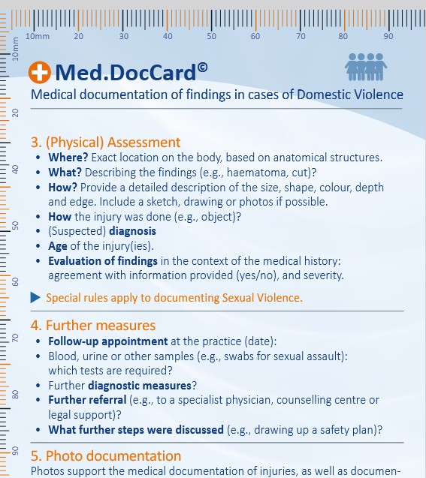
Med.DocCard
It is recommended to use bodymaps:
https://fflm.ac.uk/resources/publications/proforma-body-diagrams/:
Training materials for the health sector - Online training materials on violence

