Slide 1
Domestic violence in the Health Sector
45 min workshop
Speaker(s):
Occasion:
Date: DD month 20YY

Slide 2
Introduction

Slide 3
Outline of the Presentation
Topic
Topic
Topic

Slide 4

Introduction
What do you associate with domestic violence?
How do you feel about domestic violence?
Does domestic violence play any role in health services?
Image by storyset on Freepik

Slide 5

WHO - Video: Violence against women:

Slide 6

Physicians are important frontline responders!
Over 1 in 5 women make their first disclosure of domestic violence to their general practitioner.
You may be the only person the victim will tell.
Your skills and sensitivity are essential.

Slide 7
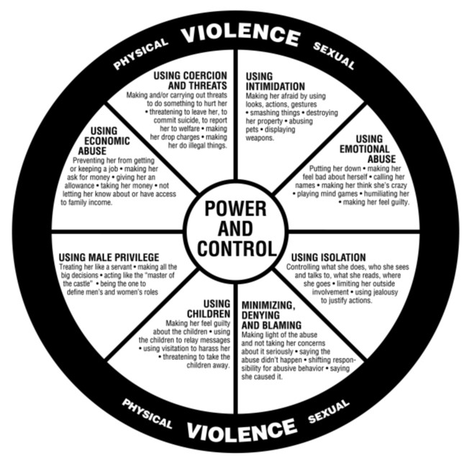
What includes domestic violence?
abuse of power within a domestic relationship
one person dominating or controlling another, causing intimidation or fear, or both
often experienced as a pattern of abuse that escalates over time
Notes:
Domestic violence is an abuse of power within a domestic relationship.
It involves one person dominating or controlling another, causing intimidation or fear, or both.
Domestic violence is often experienced as a pattern of abuse that escalates over time.
The Power and Control Wheel illustrates the most common abusive behaviours and tactics.
Detailed information on the forms and dynamics of domestic violence is provided in module 1.

Slide 8
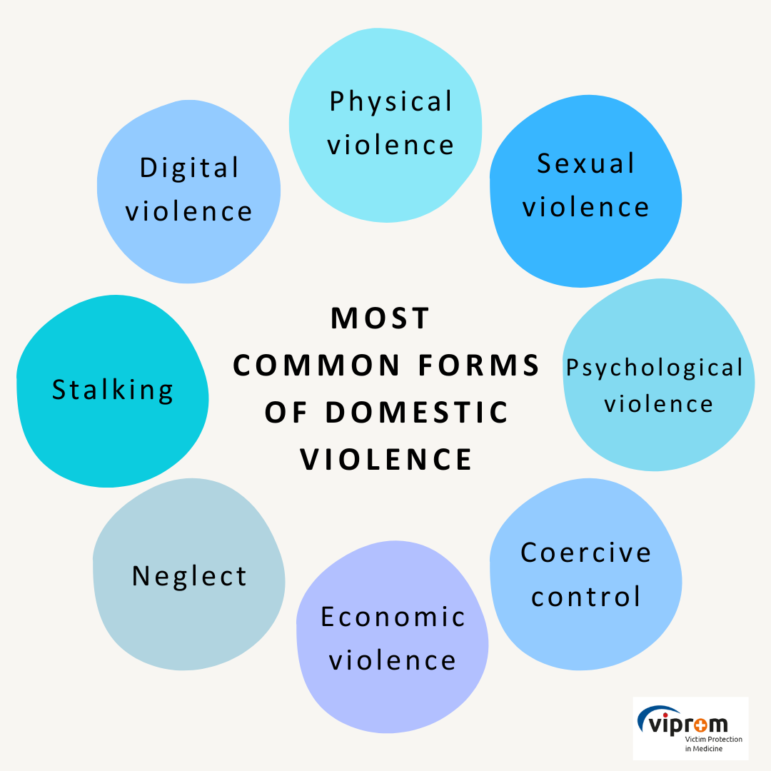
Common forms of Domestic violence
Image by storyset on Freepik
Which forms of domestic violence are unknown to you?
Notes:
Physical violence is any use of physical force or threat by use of physical force which compels the victim to do or to abandon or to suffer or restrict or move her/him or to cause her/him pain, fear or humiliation, whether personal injury has occurred.
Psychological violence is the conduct and dissemination of information by which the perpetrator of violence in the victim causes fear, humiliation, feelings of inferiority, danger and other psychological distress, even when committed using information and communication technology.
Sexual violence is the conduct of sexual content that the victim does not consent to, is coerced into, or because of their level of development, does not understand their meaning, the threat of sexual violence, and the public disclosure of sexual content about the victim.
Verbal Violence is part of psychological violence. Everything said by the perpetrator to or about the victim in order to harm him or her.
Economic violence is the unjustified control or restriction of a victim in disposing of income or property with which the victim independently disposes or manages or unjustifiably restricting the disposition or management of joint property of family members, unjustified failure to fulfil financial or property obligations to a family member or unjustified shifting financial or property liabilities to a family member.
Neglect is a form of violence where the perpetrator abandons the due care of the victim, which is needed due to illness, disability, age, developmental or other personal circumstances.
Stalking is a wilful repeated unwanted contact, pursuit, physical intrusion, observation, restraint in places where the victim moves or other form of unwanted intrusion into the victim's life.

Slide 9
Indicators

Slide 10
Of note!
None or all of these might be present and be indicators of other issues
Using indicators as a guide can complement the practice of asking directly
Victims of domestic violence often see a physician without bringing up the violence.
Women in particular are often victims of domestic violence due to power relations, local customs, cultural background or given differences in strength.
Therefore, it is particularly important to recognise indicators and risk factors as such and to exclude other causes for injuries.
Notes:
The following are examples of indicators associated with victims of domestic violence.
Indicators of domestic violence are dealt with in more detail in module 2.

Slide 11
Physical Indicators - Adults
Adults
unexplained bruising and other injuries
miscarriages and other pregnancy complications
chronic conditions including headaches, pain and aches in muscles, joints and back
sexually transmitted infection and other gynaecological problems

Slide 12
Psychological Indicators - Adults
Adults
emotional distress
sleeping and eating disorders
self-harm or suicide attempts
alcohol or drug abuse

Slide 13
Other indicators
Several presentations in the emergency department
Patient arrives after the official consultation hour
Patient only comes in the presence of his/her partner, who has a controlling effect
Frequent absence, for example from work or study

Slide 14
Physical Indicators - Children
Children
difficulty sleeping
physical complaints
eating disorders
slow weight gain (in infants)

Slide 15
Psychological Indicators - Children
Children
aggressive behaviour and language
bedwetting
restlessness and problems with concentration
noticeable decline in school performance

Slide 16

Domestic violence in Health Services

Slide 17
Communication

Slide 18
Never assume and always ask!
But how?
Image by storyset on Freepik

Slide 19
First step: take over victim´s perspective
They may feel…
Insecure
Lack of trust
Fear of potential consequences
Low self-confidence
Low self-worth
19
19

Slide 20
Communication (attitude) aspects
Respect
Trust
Confidence and empathy
Private
Exclusion of potential perpetrator or other familiy members
Use „I“ messages
Non-violent communication models

Slide 21
Possible questions
Start:
“I have some questions that I ask every patient. I’m going to ask you these questions now, too.”
General questions
Framing the question

Slide 22
Possible indirect questions
“How are things at home?”
“I know many people have problems facing violence by their partners, other family members, or someone else they live with. Could it be, that this is the same in your case?”
“Because unfortunately violence is so common in our society, I have started asking all of my patients about it.”
“I’m going to ask you a question that I ask all patients.”
Notes:
In any situation that you suspect underlying psycho-social problems you can ask indirectly and then directly about domestic violence.
If you have concerns that your patient is experiencing domestic violence, you should ask to speak with them alone, separate from their partner or any other family members.
You can always ask broad questions about whether your patient’s relationships are affecting their health and wellbeing.

Slide 23

Possible direct questions
“Are you ever afraid at home or in your relationship?”
“Have you ever been slapped, pushed or shoved by someone close to you?
Additive approaches by
non-verbal communication
International sign for help
Notes:
It is important to realize that victims who have been abused want to be asked about domestic violence and are more likely to disclose if asked.
If appropriate, you can ask direct questions about any violence.

Slide 24
How to talk to your patient about domestic violence – Specific questions
‘You seem very anxious and nervous. Is everything alright at home?’
‘When I see injuries like this, I wonder if someone could have hurt you?’
‘Is there anything else that we haven’t talked about that might be contributing to this condition?’
Use of interpreters:
Work with a qualified interpreter if your patient’s fluency in your mother tongue is a barrier.
→ Don’t use your patient’s partner, other family members or a child as an interpreter!
Notes:
If you see specific clinical symptoms, you can ask specific questions about these (e.g. bruising).
If your patient’s fluency in English is a barrier to discussing these issues, you should work with a qualified interpreter.
Don’t use your patient’s partner, other family members or a child as an interpreter. It could compromise their safety or make them uncomfortable to talk with you about their situation.
How to talk to victims of domestic violence is the subject of module 3. For more information, please visit this module.

Slide 25
Possible questions
Start:
“I have some questions that I ask every patient. I’m going to ask you these questions now, too.”
General questions
Framing the question

Slide 26
Response after disclosure

Slide 27
Principles: Responding to a disclosure
Listen
Communicate belief
Validate the decision to disclose
Emphasize the unacceptability of violence
Be clear that the victim is not to blame
Notes:
Your immediate response and attitude when your patient discloses domestic violence can make a difference.
Victims require an initial response to disclosure, where they are listened to, validated and their own and their children’s safety is assessed.
They also need to be assisted on a pathway to safety.
Aspects that should be considered after the disclosure of domestic violence such as medical assessment and securing of evidence are addressed in module 4.

Slide 28
Initial risk assessment
Evaluate the immediate and future safety of the victim
Seek relevant facts about their particular situation, and their own perception of risk
Use your professional judgment
Refer your patient to a specialized domestic violence service
Notes:
Assist your patient to evaluate their immediate and future safety, and that of their children.
Best-practice risk assessment involves seeking relevant facts about their particular situation, asking them about their own perception of risk, and using professional judgment.
You may need to refer your patient to a specialized domestic violence service.

Slide 29
Aspects of best-practice risk assessment
Speak to your patient alone
Check for immediate concerns
Check your patient’s future safety
Notes:
It is essential that you engage the person in a conversation about their perceptions of risk and how they have managed their safety in the past.
Find more information on risk assessment and safety planning in module 5.

Slide 30
Mandatory reporting – country-specific!
If a child is at risk of significant harm, you need to report this to Community Services/ the Youth Welfare Service
You are not obliged to report violence experienced by adults as long as there is no risk of suicide or endangerment of third parties
Reporting violence experienced by adults without their consent could put them at greater risk of harm

Slide 31
Stages of effective response
Non-judgemental listening & validation
Initial risk assessment
Note-taking for legal purposes
Referrals
Mandatory reporting
Continuing care
Notes:
Referrals: e.g. Police, Domestic Violence Line, legal advice, victim support
Note-taking for legal purposes: documenting injuries
Mandatory reporting: if required
Indicators of domestic violence are dealt with in more detail in module 2.

Slide 32
Documentation

Slide 33
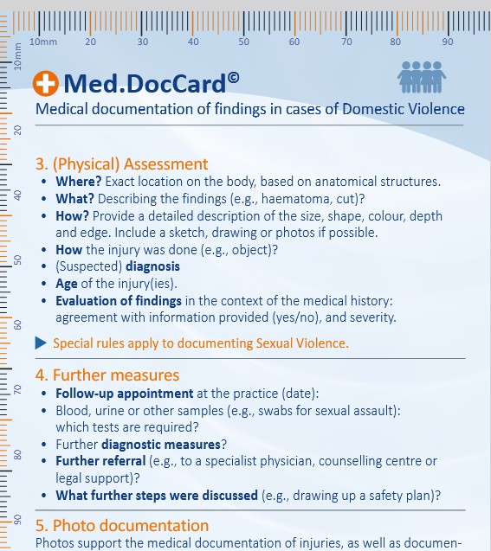
Med.DocCard
It is recommended to use bodymaps:
https://fflm.ac.uk/resources/publications/proforma-body-diagrams/:
Training materials for the health sector - Online training materials on violence

